Slide 1
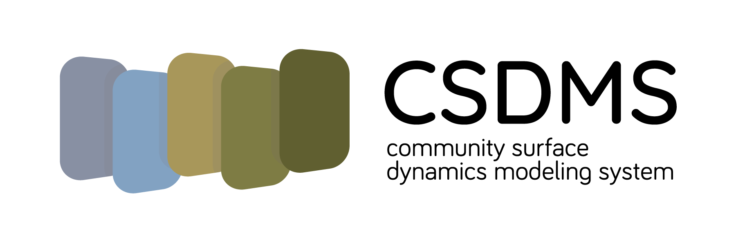
Under the Hood: Landscape Evolution Modeling with TerrainBento and Landlab
CSDMS Clinic
May 20 2021 - 11:00am - 1pm MDT
Benjamin Campforts & Vanessa Gabel

Slide 2
Agenda
Introduction (11.00-1.10)
Introduction | 11.00-11.10
Landlab | 11.10 -12.00
break | 12.00-12.10
Terrainbento | 12.10- 1pm

Slide 3
Landscape evolution Models
Why LEMs
provide insight into the geomorphic history
create testable predictions of landform development
demonstrate the consequences of current geomorphic process theory
spark imagination through hypothetical scenarios

Slide 4
Building 2D Numerical Models with Landlab

Slide 5
Spatially distributed (2D) process models are vital for studying earth’s surface
… and model codes have some interesting things in common
CATCHMENT HYDROLOGY
(Ivanov et al., 2004)
SOIL EROSION
(Mitas and Mitasova, 1998)
GLACIER DYNAMICS
(Kessler et al., 2006)
LANDSCAPE EVOLUTION
(Tucker and Hancock, 2010)
IMPACT CRATERING AND DEGRADATION
(Howard, 2007)
LAVA FLOWS
(Kelfoun et al., 2009)

Slide 6


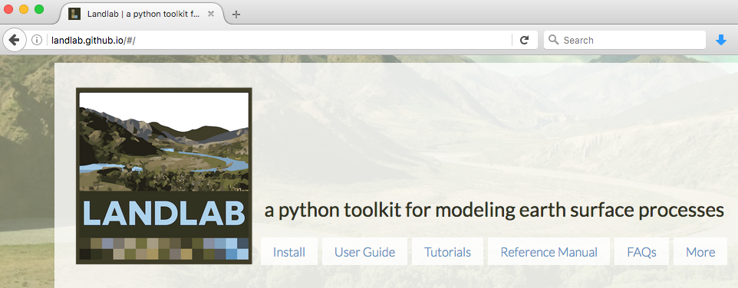
What is Landlab?
A Python-language programming library
Supports efficient creation and/or coupling of 2D numerical models
Geared toward (but not limited to) earth-surface dynamics
Companion to CSDMS Python Modeling Tool (PyMT)
landlab.github.io

Slide 7
Why Terrainbento
4 last decades
many alternative formulations for the redistribution of mass by Earth surface processes,
relatively few studies have systematically compared and tested these alternative equations

Slide 8
Landlab

Slide 9
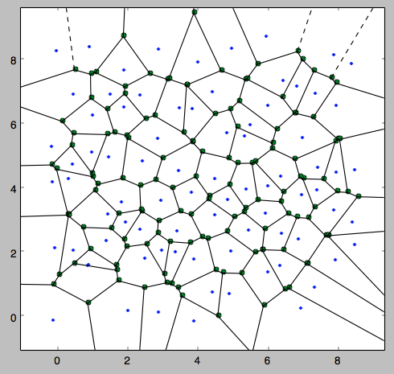
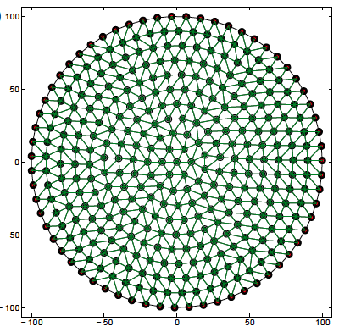
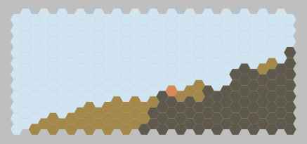
Landlab: grid management
Grids are objects
Grids use flat arrays
Data fields can be attached to grid elements
Multiple grid types
Built-in numerical functions:
gradient
divergence
VORONOI / DELAUNAY
RASTER
RADIAL
HEXAGONAL

Slide 10
grid = RasterModelGrid(shape=(10, 16))
NODE
LINK
CELL
grid = HexModelGrid(
shape=(16, 10),
node_layout=‘rect’,
orientation=‘vertical’)
grid = HexModelGrid(shape=(11, 10))
grid = RadialModelGrid((3, 5))
Delaunay triangulation
with Voronoi polygons

Slide 11
Building a model with Landlab components
Output
Parameters
Data
DRIVER
(Python script)
COMPONENT 1
COMPONENT 2
…
COMPONENT N
GRID
…
FIELD 1
FIELD 2
FIELD N

Slide 12
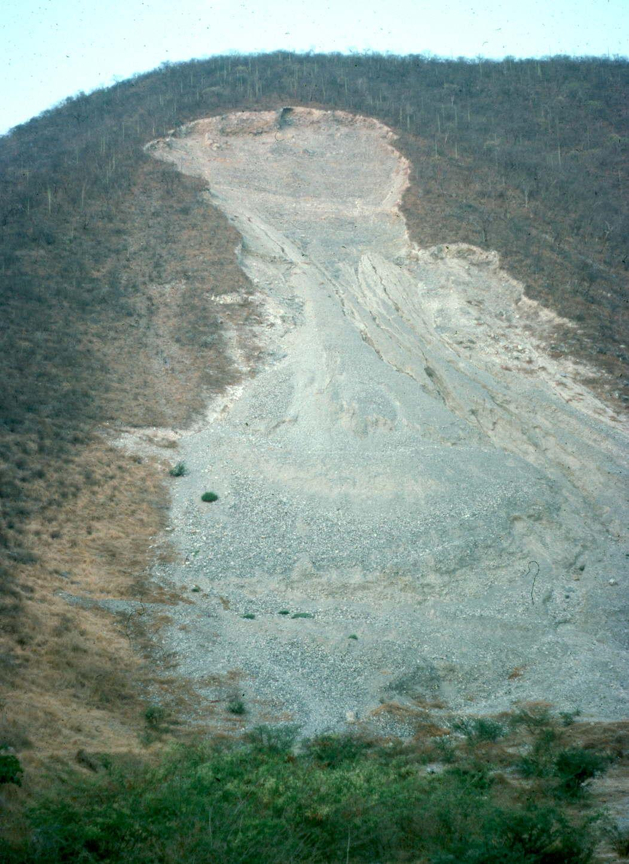
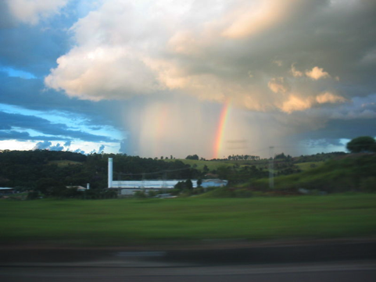
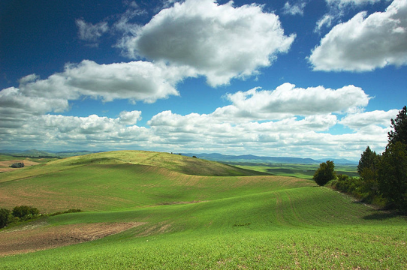
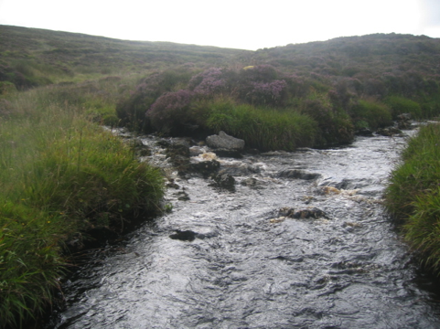
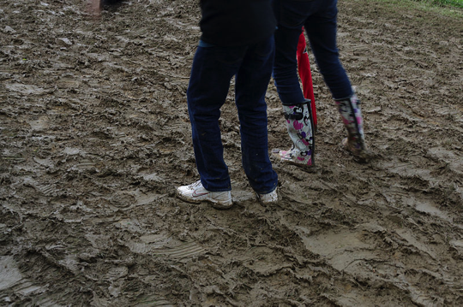
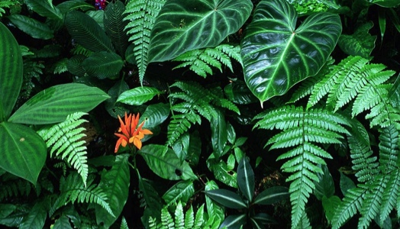
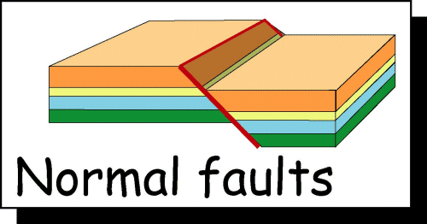
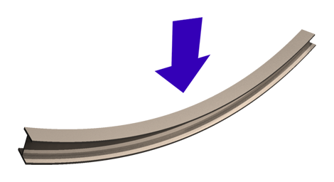
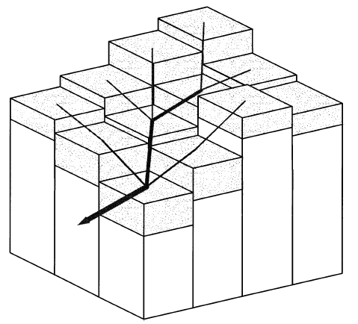
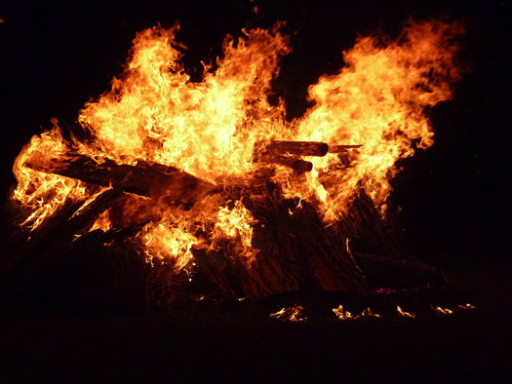
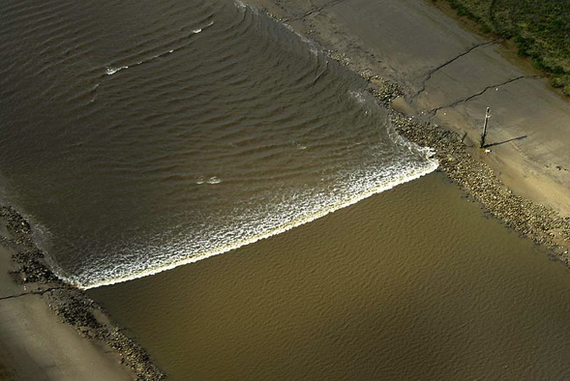
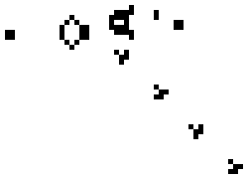
Some process components in the toolkit
STOCHASTIC
STORM GENERATION
SOIL CREEP
CHANNEL INCISION
LANDSLIDE PROBABILITY
SOIL MOISTURE
DYNAMICS
LITHOSPHERE
FLEXURE
VEGETATION GROWTH
NORMAL FAULTING
SHALLOW-WATER
HYDRODYNAMICS
FLOW ROUTING
STOCHASTIC
FIRE GENERATION
CELLULAR
AUTOMATA

Slide 13
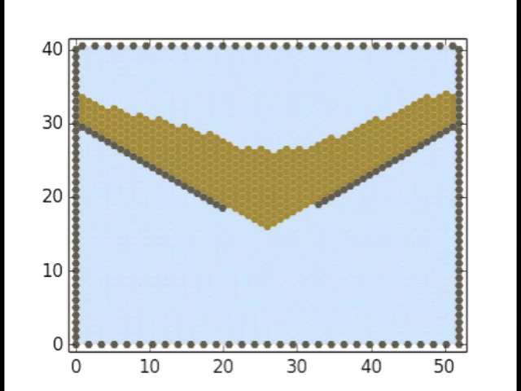
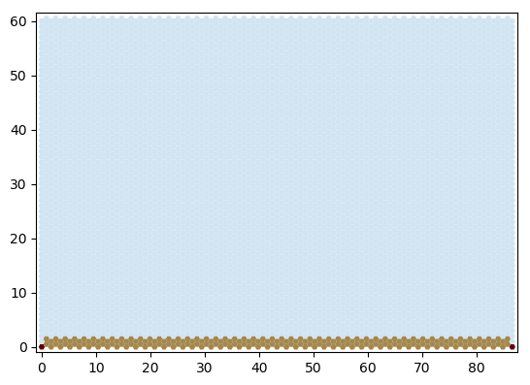
Cellular automaton package
CellLab-CTS: Continuous-time stochastic CA
(Tucker et al., 2016 Geoscientific Model Development;
2018 Earth Surface Dynamics)

Slide 14
Other handy tools
Input and output
Parameter input from formatted text file
Read and/or write gridded data:
ESRI ASCII
netCDF
DEM analysis and pre-processing
Configure “watershed” boundary conditions
Other terrain analysis functions
Basic plotting with Matplotlib
EX: (mygrid, topo) = read_esri_ascii(‘my_dem.txt’)

Slide 15
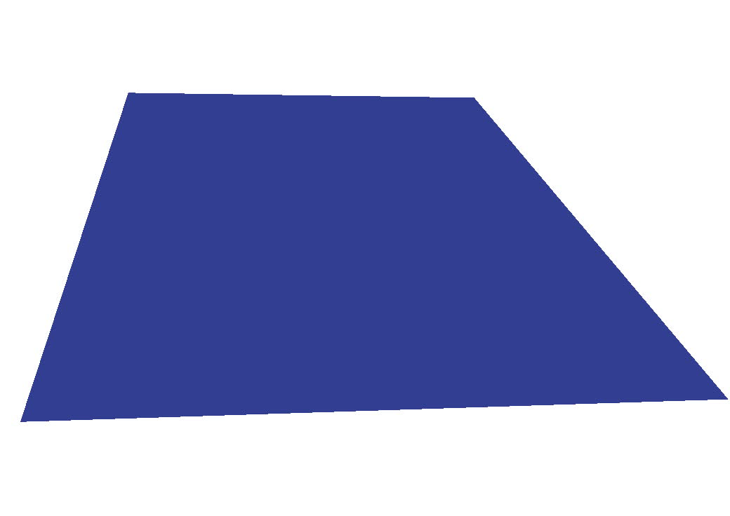
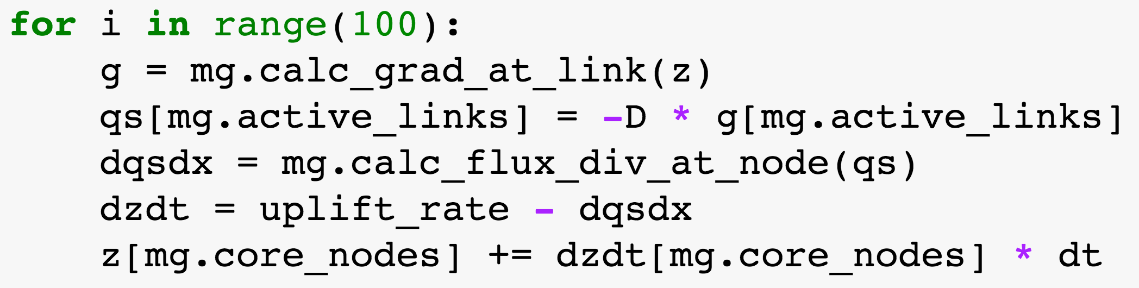
Example: 6-line diffusion model

Slide 16
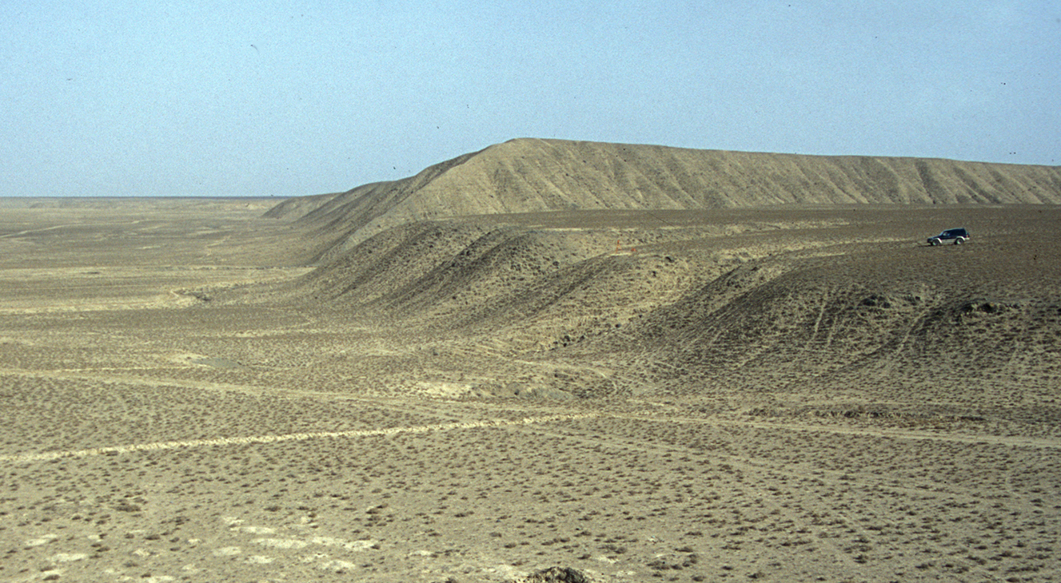
Tutorial #1: modeling the erosional degradation of a fault scarp using linear diffusion theory

Slide 17
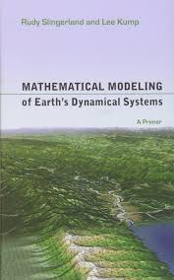
SOIL MASS IS CONSERVED ➔
SOIL CREEPS DOWNHILL ➔

Slide 18
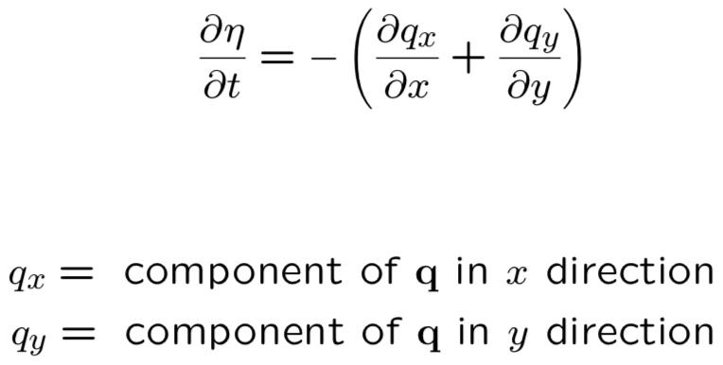
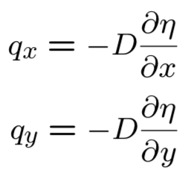
SOIL MASS IS CONSERVED ➔
SOIL CREEPS DOWNHILL ➔

Slide 19
Imagine a world of cells
Δx
Δx
Model will keep track of soil volume inside each cell

Slide 20
Inside each cell is a node
Model will keep track of land surface height at each node

Slide 21
Add a ring of boundary nodes

Slide 22
Number the nodes from lower left to upper right
24
25
26
27
28
29
18
19
20
21
22
23
12
13
14
15
16
17
6
7
8
9
10
11
0
1
2
3
4
5

Slide 23
Definition: q
Volume soil flux per width per time across a cell face [m²/yr]
Positive if flow is to east or north
Negative if flow is to west or south

Slide 24
Soil volume balance
Soil volume in a cell is height times surface area, or η Δx²
Time rate of change of soil volume at cell i is the sum of inflows/outflows across the four faces
If inflow rate per unit width for a given face is q, then total volume inflow rate is q times width, or q Δx

Slide 25
Soil volume balance
q_{west} Δx

Slide 26
Soil volume balance
q_{west} Δx
q_{east} Δx

Slide 27
Soil volume balance
q_{west} Δx
q_{east} Δx
q_{south} Δx

Slide 28
Soil volume balance
q_{north} Δx
q_{west} Δx
q_{east} Δx
q_{south} Δx

Slide 29
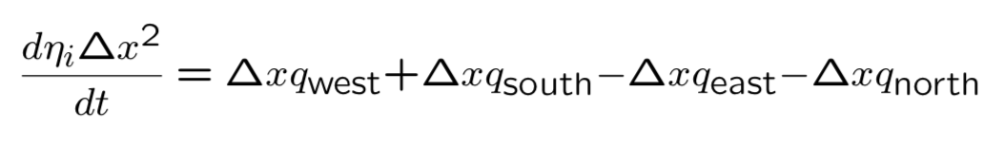
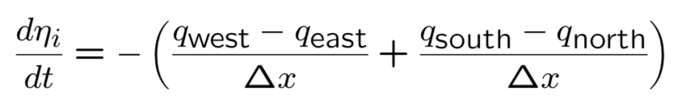
Soil volume balance: math for this finite volume scheme
Now, how do we calculate q?

Slide 32
Some notebook demos from the Landlab tutorials collection These and other tutorials can be found via the Landlab website: http://landlab.github.io

